Slide 1
Reporting UPK Programs
2023-2024

Slide 2
Preschool vs Pre-K
Preschool
Pre-K
The term “preschool” means children referred to the CPSE for special education eligibility determination (i.e., those with a Reason for Beginning Enrollment Code 4034), or
Students receiving preschool special education services (Reason for Beginning Enrollment Code 0011).
Both groups reported with Grade of “PRES”
The term “prekindergarten” means students, with and without disabilities, who are enrolled in a prekindergarten program that can be a Universal Pre-K (UPK) program or other Pre-K program.
Enrolled with a Reason for Beginning Code 0011
Reported with Grade of “PKH” or “PKF” depending on whether the Pre-K program they are in is Half or Full day.

Slide 3
Pre-K Enrollments
Enrollment Locations
Students attending Pre-K programs in a school within the district should be enrolled with the 0011 code and the School BEDS code as the location
Students attending Pre-K programs operated under contract with the district (other locations such as day care centers, nursery schools, etc) should be enrolled with the 0011 code and 0666 as the location
Grade Level
PKH – half day program
PKF – full day program
A CPSE student who is enrolled in a Pre-K program should be enrolled as a Pre-K student with a grade level of PKH or PKF

Slide 4
Pre-K Program Services
UPK – Universal Pre-Kindergarten (902)
Other Pre-Kindergarten (990)
Any child whose Pre-K placement is funded solely by the allocational UPK grant must be reported with Program Service Code 902 (UPK).
Children whose half-day UPK placement has been converted to full-day using the Statewide Universal Full-day Prekindergarten (SUFDPK) grant should be reported with Program Service Code 902 (UPK) and grade level PKF (full-day).
Program Service Codes
902 – UPK program service code
UPK setting code
Students who are 3 or 4 years old
Students in any other type of Pre-K programs
Program Service code
990 – Other Pre-Kindergarten

Slide 5
Level 0 > Reports > Program Fact

Slide 6
Pre-K State Funded Grants
Universal Pre-kindergarten (UPK)
Half day pre-kindergarten programs for 3 and 4 year olds
Districts who already received UPK or SUFDPK funding in previous years may use funds to supplement their current programs for full day 4 year old students
Statewide Universal Full Day Pre-kindergarten (SUFDPK)
Full day pre-kindergarten programs for 4 year olds
Districts with existing UPK programs can use SUFDPK funds to supplement their current programs with conversion slots or new full-day slots for 4 year olds
Targeted Prekindergarten (TPK)
TPK grants are awarded to BOCES organizations to offer pre-kindergarten to economically disadvantaged students
None of our districts have students in Targeted Prekindergarten programs
UPK Reporting Memo: https://www.nysed.gov/memo/early-learning/2023-2024-prek-child-counts-reporting-deadline-and-guidance-reporting-date-upk
Description of State-Administered PreK Programs: http://www.nysed.gov/early-learning/state-administered-prekindergarten-programs-applications

Slide 7
Description | Grade Level | Pre-K Program Code |  | UPK Setting Code
 |  | 902 (Universal PreK) | 990 (“Other” PreK) | See SIRS Manual for codes
Any child whose Pre-K placement is funded solely by the allocational Universal Pre-K (UPK) grant Associated Funding Project Codes for Districts: 0409-24-XXXX 5870-24-XXXX | PKF or PKH | X |  | Required
Child whose half-day UPK placement has been converted to full-day using Statewide Universal Full-day Prekindergarten grant (SUFDPK) (For example, a child whose placement is funded for the first half-day by the allocational UPK program and the second half of the day by the SUFDPK program.) Associated Funding Project Codes for Districts: 0409-24-XXXX 0545-24-XXXX 0546-24-XXXX | PKF | X |  | Required
New full-day placements funded by Statewide Universal Full-day Prekindergarten (SUFDPK) Associated Project Codes for Districts: 0545-24-XXXX 5875-24-XXXX 0546-24-XXXX | PKF |  | X | Not Required
https://www.nysed.gov/memo/early-learning/2023-2024-prek-child-counts-reporting-deadline-and-guidance-reporting-date-upk

Slide 8
Universal Prekindergarten (State) | Statewide Universal Full-day Prekindergarten | Universal Prekindergarten (Federal) | Universal Prekindergarten Expansion Grant for New Full-Day Placements for 4-Year-Old Students | Universal Prekindergarten Expansion Grant for New Full-Day & Half-Day to Full-Day Placements for 4-Year-Old Students
UPK Project #: 0409-24 | *SUFDPK Project #: 0545-24 | UPK Project # : 5870-24 | SUFDPK Project # : 5875-24 | SUFDPK Project # : 0546-24
902 UPK | 990 Other PreK/902 UPK | 902 UPK | 990 – Other PreK | 990 – Other PreK
Allocations List 3 & 4-year-old students Half-Day or Full-Day | Grant Award Chart 4-year-old students New Full-Day - 990 Conversion Slots - 902 | Allocations List 4-year-old students Full-Day Only | Grant Award List 4-year-old students Full-Day Only | Grant Award List 4-year-old students Full-Day Only (provided by conversion slots and/or new full-day slots)
*Students funded as SUFDPK (Project 0545) whose ½ day UPK placement has been converted to full day should be reported in SIRS as 902 while students funded as SUFDPK (Project 0545) for new full day slots should be reported in SIRS as 990
Handbook: https://www.nysed.gov/sites/default/files/programs/early-learning/office-of-early-learning-fiscal-guidance-handbook-2022-2023.pdf
Lists & Charts: http://www.nysed.gov/early-learning/state-administered-prekindergarten-programs-allocations-and-financial-forms

Slide 9
Districts with 0409 and 5870 (code 902)
UPK 0409
UpK 5870
All 19 districts have 0409
Brighton
Churchville
East Irondequoit
Fairport
Hilton
Honeoye Falls-Lima
Penfield
Pittsford
Rush-Henrietta
Spencerport
Webster
West Irondequoit
Wheatland

Slide 10
Districts with 0545 and 5875 (code 990)
SUFDPK 0545
SUFDPK 5875
Fairport
Gates
Greece
Rush-Henrietta

Slide 11
Reporting Data
SIRS Templates: Demographics, Enrollment, and Program Fact
SIRS-333: Pre-K student enrollment counts are displayed for a single snapshot on March 13. The enrollment counts on the snapshot date will only include students who were enrolled in UPK programs on March 13th.
Sept Memo: The first pull date will be in March 15. The last day to fix any coding errors for the 23-24 school year will be June 6, 2024
If you have any non-resident students who attend a Pre-K program using your district’s UPK funds, be sure to report them as well.

Slide 12
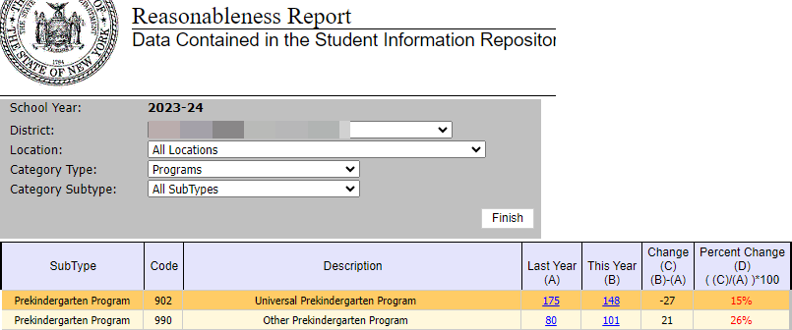
SIRS-401

Slide 13
SIRS-333

Slide 14
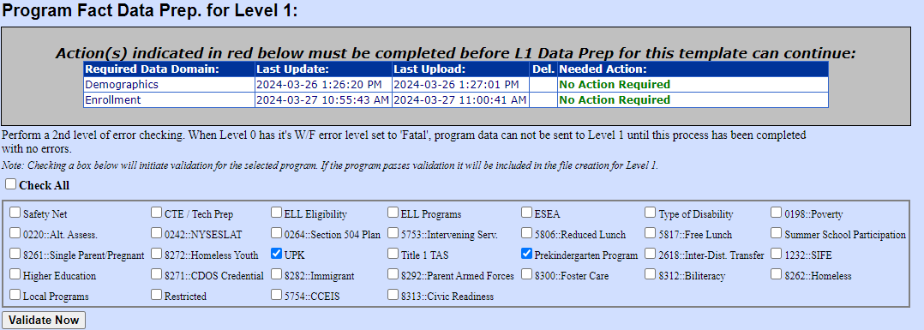
Deleting UPK and PreK Programs
If you need to delete ALL records for a program service code, you need to contact Matt Fredericks or Laurie Hazard so we can request a purge of the records from Level 1.
WHY?
Level 1 only purges and replaces records for program codes included in the file sent.
If a program code has zero records, then that program code will not be in the file even if you select it on the L1 Data Prep screen.
Therefore, Level 1 will not purge the records for the program code.

Slide 15
UPK SWD Transition to Kindergarten
Description of Students | Accountability or Instructional Responsibility | CSE/CPSE Responsibility | Who Will Report Data to SIRS and Using What Code (i.e., District of Responsibility) | Location/BEDS Code (i.e., Building of Enrollment)
6) A preschool student with a disability who is transitioning to Kindergarten, will not receive extended school-year services and was enrolled in a UPK program or another PK program. | District of residence (Instructional) Not applicable (Accountability) | District of residence | District of residence (Reason for Beginning Enrollment Code 0011) | There are three options to report these students in July and August: If the UPK program was run by the district and the district chooses to continue to report the location where the student attended the UPK program, the BEDS code of the school the student attends If the UPK program the student attended is contracted by the district and the district chooses to continue to report the location where the student attended the UPK program, the first 8digits of the district BEDS code and “0666” as the last 4 digits. If the district does not choose to report the location where the student attended the UPK program, the first 8 digits of the district BEDS code and “0777” as the last 4 digits. For options 1 and 2, the student will be reported with the grade PKF or PKH from July 1-August 31. For option 3, the student will be reported with the grade PS from July 1- August 31.
Preschool Age (CPSE) Transition to Kindergarten Age - Data Points table and worksheet 32624.pdf (monroe2boces.org)

Slide 16
Resources
Allocations Lists: http://www.nysed.gov/early-learning/state-administered-prekindergarten-programs-allocations-and-financial-forms
September Memo: https://www.nysed.gov/memo/early-learning/2023-2024-prek-child-counts-reporting-deadline-and-guidance-reporting-date-upk
Office of Early Learning Fiscal Guidance Handbook: http://www.nysed.gov/common/nysed/files/programs/early-learning/office-of-early-learning-fiscal-guidance-handbook-2022-2023.pdf
FAQ: http://www.nysed.gov/early-learning/frequently-asked-questions-faq
Contact the Office of Early Learning: OEL@nysed.gov - use “2023-24 UPK Child Counts” in subject line
SIRS-333 Report Guide: https://www.p12.nysed.gov/irs/level2reports/sirs-333-annual-pre-k-enrollment-summary-report-guide.pdf

